Slide 1

School of Engineering and technology
Garima Sharma
Under Supervision of Dr.Aman Jatain

Slide 2
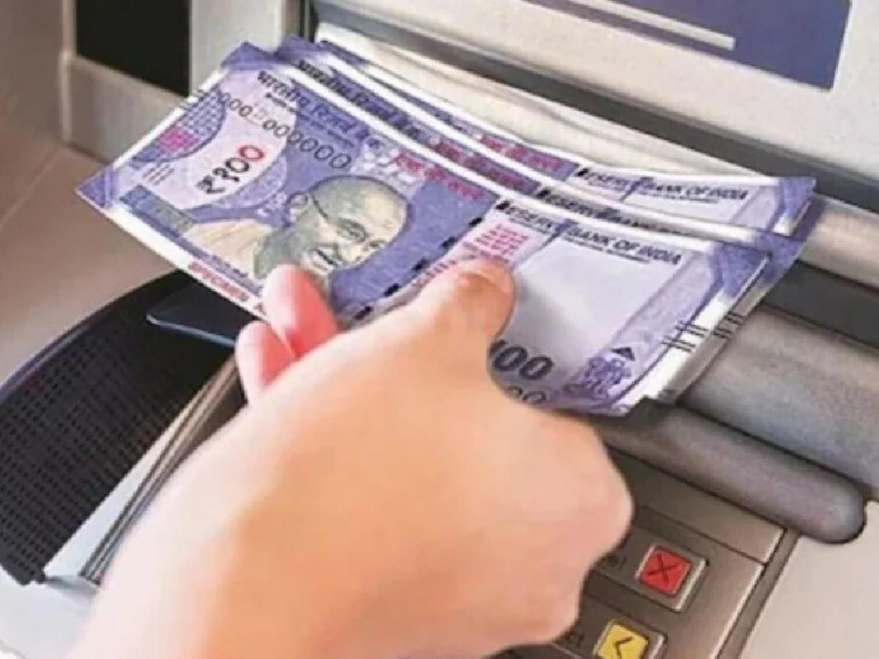
Secure ATM Using Card, OTP, and Biometric Authentication
Enhancing ATM Security with Multi-Factor Authentication

Slide 3
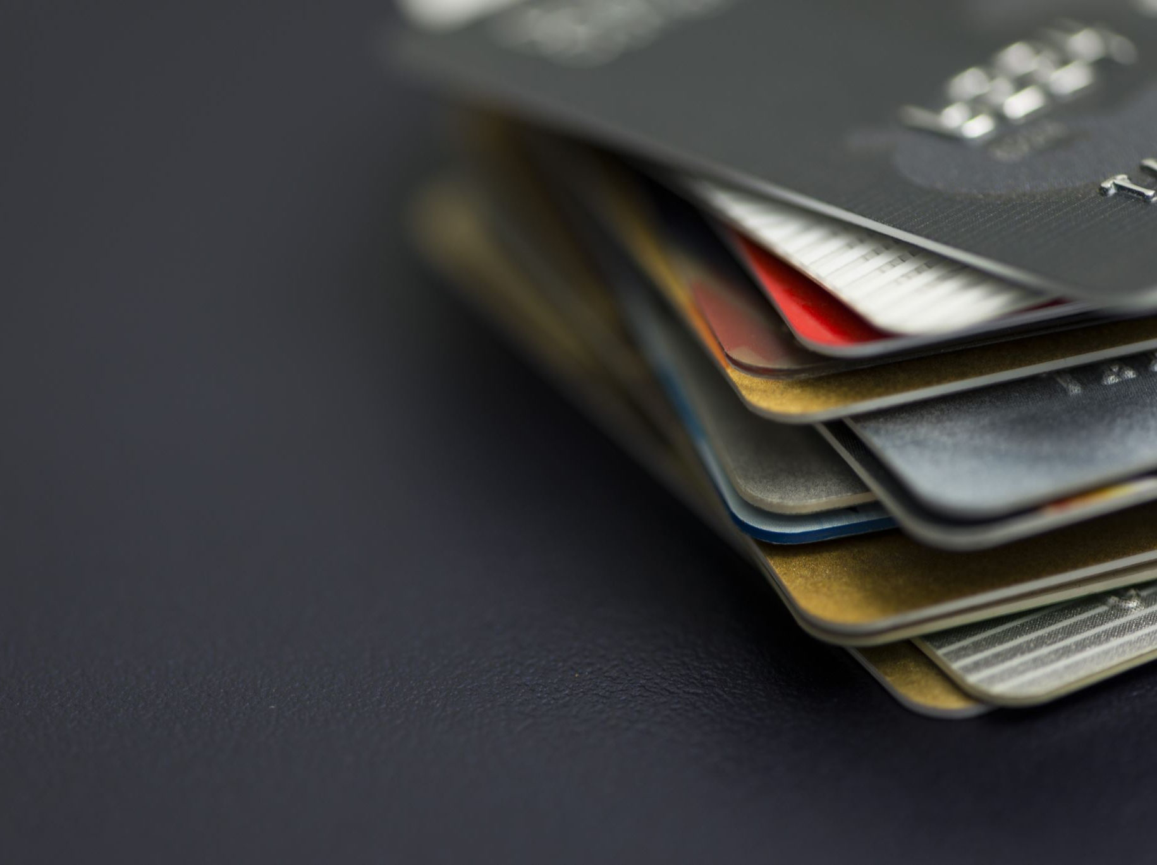
Introduction
- ATMs are vulnerable to fraud
(skimming, PIN theft, card cloning).
- Traditional CARD+ PIN authentication is not fully secure.
- Multi-Factor Authentication (MFA) improves security using:
1. ATM Card (something you have)
2. OTP on Mobile (something you know)
3. Biometric Authentication (something you are)

Slide 4
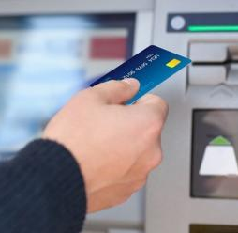

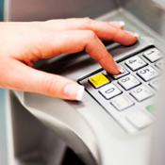
Existing ATM Security Issues
- Card skimming and cloning
- Shoulder surfing (PIN theft)
- Stolen or lost cards
- Lack of real-time identity verification

Slide 5

What is Card + OTP + Biometric Authentication?
- Uses Three-Factor Authentication (3FA):
1. ATM Card for user identification
2. OTP sent to Registered Mobile for transaction approval
3. Biometric Authentication (Fingerprint/Iris/Face Recognition) for final verification

Slide 6
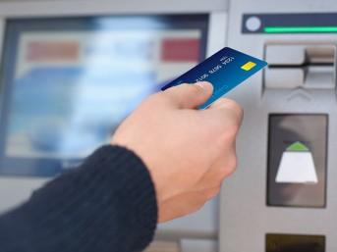
Working of Secure ATM System
1. Insert ATM card
2. Enter PIN (optional)
3. OTP sent to registered mobile
4. Enter OTP in ATM machine
5. Scan fingerprint/iris/face for biometric authentication
6. Transaction is verified and processed

Slide 7
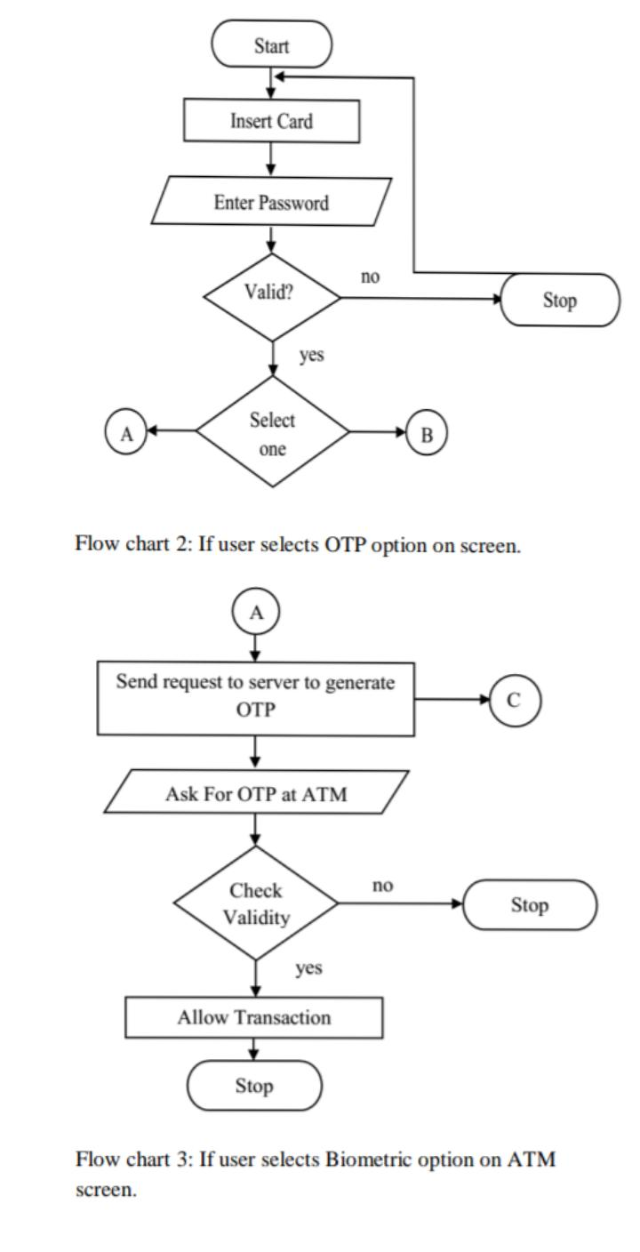
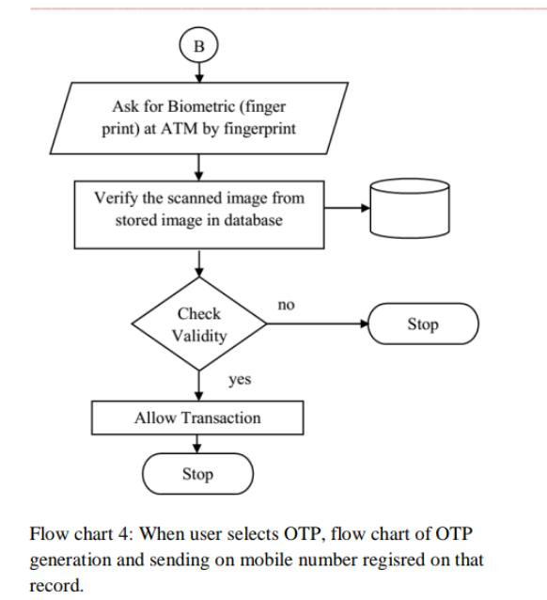
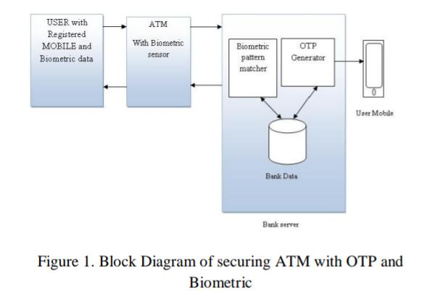
Methodology

Slide 8


Technologies Used
- Secure OTP Generation (via SMS, Email, or App)
- Biometric Sensors (Fingerprint, Iris Scanner, Face Recognition)
- End-to-End Encryption for data security
- AI-based Fraud Detection

Slide 9
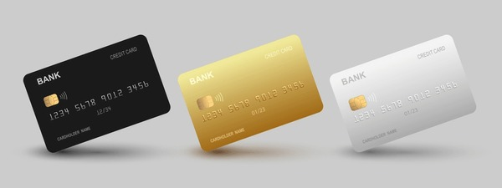

Advantages of Card + OTP + Biometric System
✔ Prevents unauthorized access (even if card & OTP are stolen)
✔ Eliminates PIN-based fraud (no need for PIN entry)
✔ Protects against card cloning & skimming
✔ Enhances user confidence & security
✔ Fast & secure transactions

Slide 10
Challenges & Solutions
- Network issues for OTP delivery → Offline OTP or Backup Authentication
- Fake biometrics (spoofing) → Liveness detection, AI-based verification
- Slow transaction processing → Optimized hardware & software integration
- Privacy concerns → Secure encryption & GDPR compliance

Slide 11
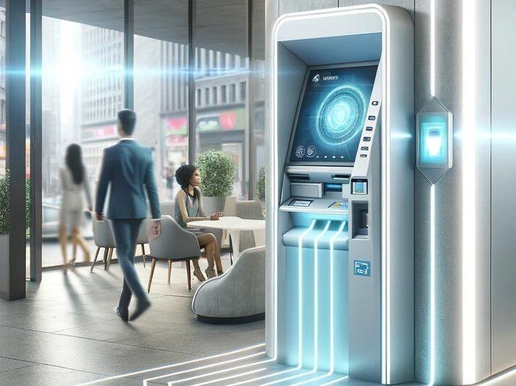
Future Enhancements
- AI-based fraud detection in real-time
- Blockchain for secure transaction logging
- Voice-based authentication as an alternative biometric

Slide 12
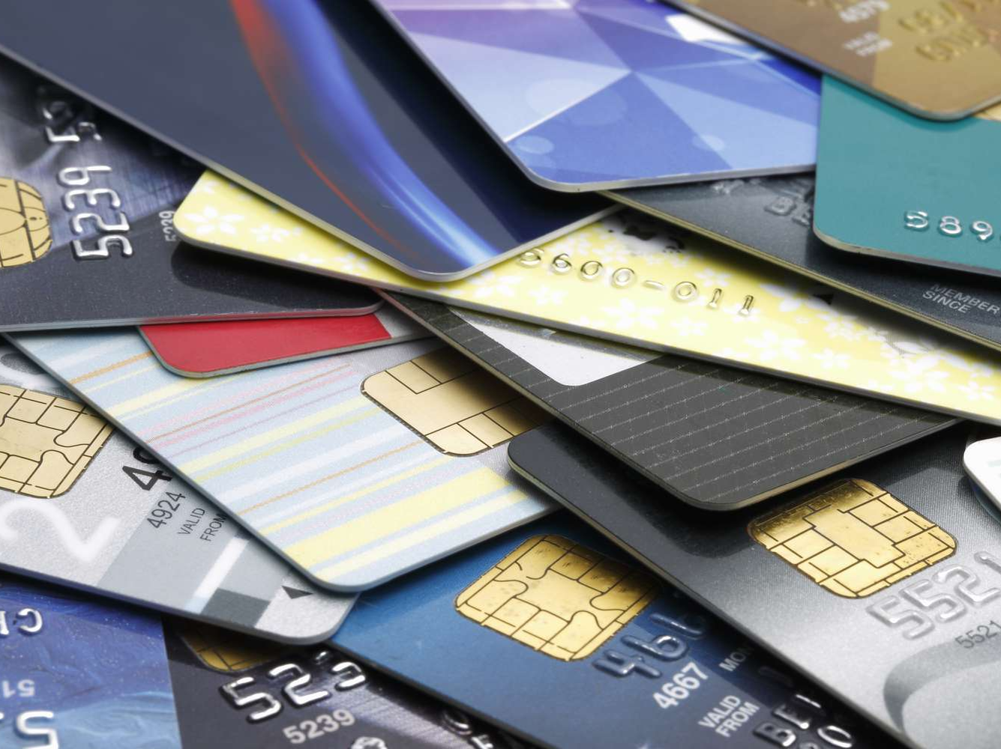
Conclusion
- Card + OTP + Biometric system significantly enhances ATM security.
- Reduces fraud risks and increases customer trust.
- Future-proofing ATMs with multi-layer security.

Slide 13

Thank You!
Any Questions?

